Slide 1
Software Design
Group 12 Iteration1

Slide 2
Table of contents
High level design

Slide 3
High level design
GUI
Controllers
Logic

Slide 4
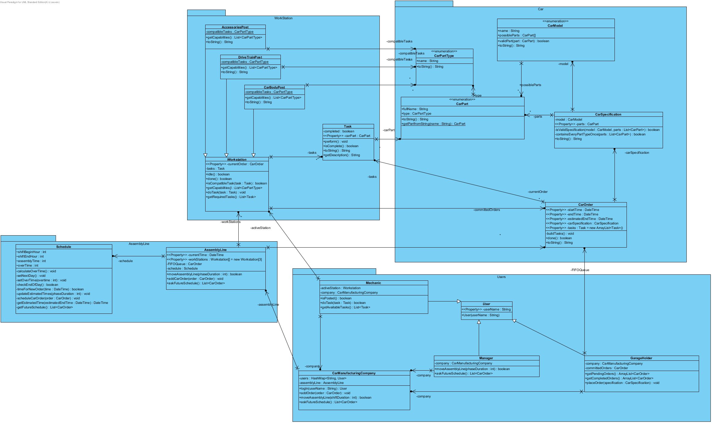
High level design

Slide 5
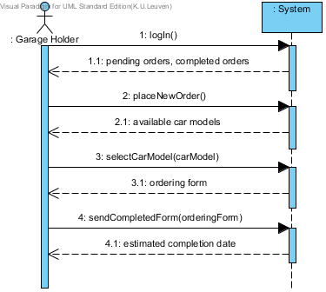
User: Garage Holder

Slide 6
User: GarageHolder
KEY CONCEPTS:
Orders
Specifications
Models -> CarModel
Options -> CarPart (catagorised in CarPartType)
A contact point (the company)

Slide 7
User: Garage Holder

Slide 8
User: Garage Holder

Slide 9
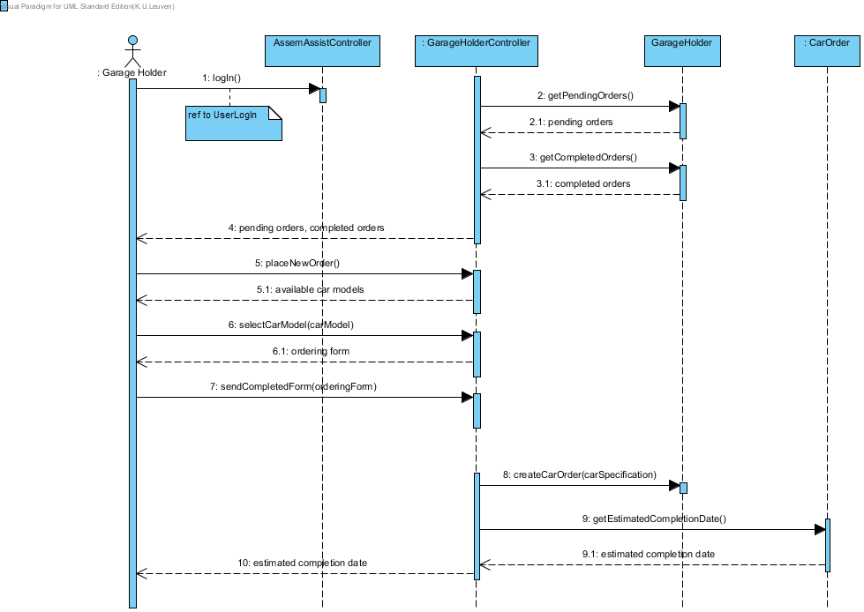
User: Garage Holder

Slide 10
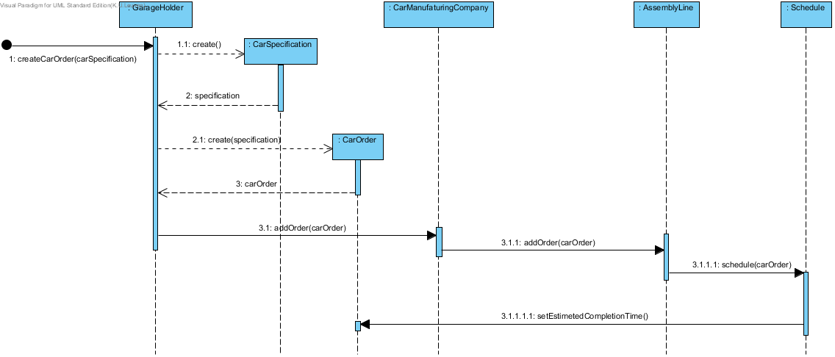
User: Garage Holder

Slide 11
High Level: GarageHolder
The Garage holder needs to know about:
CarSpecifications, (CarParts & CarModels)
CarOrders
The company (CarManufacturingCompany)
GarageHolder knows nothing of:
The manufacturing process:
Tasks, AssemblyLines, Mechanics, Managers, …

Slide 12
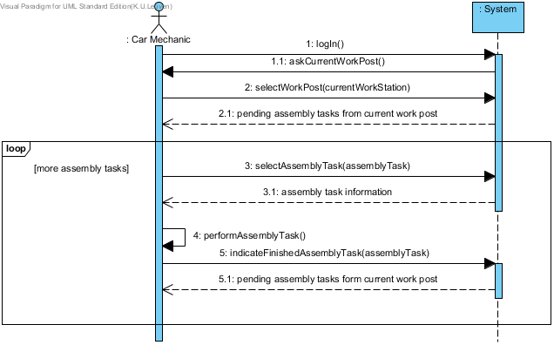
User: Mechanic

Slide 13
User: GarageHolder
KEY CONCEPTS:
Workstations
Tasks

Slide 14
User: Garage Holder

Slide 15
User: Garage Holder

Slide 16
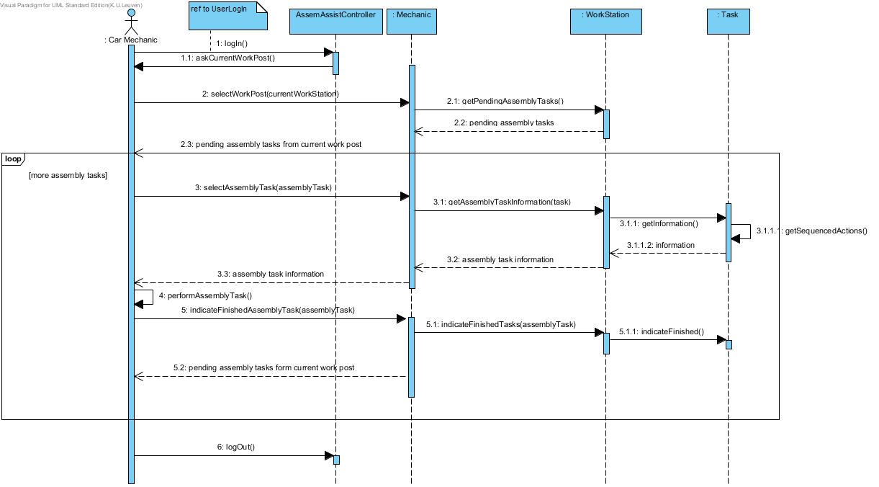
User: Mechanic

Slide 17
High Level: Mechanic
The Mechanic needs to know about:
His workstation
Tasks -> CarParts implicitly
The company (CarManufacturingCompany)
The Mechanic knows nothing of:
Orders
Scheduling, AssemblyLines, …

